Slide 1
SEGAE – Teacher training
Practical informations
Avec le soutien de

Slide 2
Welcome to Liège – Gembloux Agro-Bio Tech

Slide 3
Online meeting rules
Mute your microphone when not speaking
Shut down your camera to save bandwidth
Raise your hand when you have a question or use the chat
Prefer physical connection with cables instead of Wi-Fi
BB Callaborate works better with Google Chrome and Firefox

Slide 4
Webinar schedule
Activity | Time | Length
Welcome word | 09:00 | 00:05
Philosophy of the game | 09:05 | 00:15
Presentation of the game interface | 09:20 | 00:10
Introduction to the various modules | 09:30 | 00:40
Break | 10:10 | 00:10
Parallel Workshops on SEGAE | 10:20 | 01:00
Pedagogical offer around SEGAE | 11:20 | 00:10
Custom scenario creation and multiplayer games | 11:30 | 00:10
General discussion and questions | 11:45 | 00:15
Conclusion | 12:00 | 00:05

Slide 5
Thanks for your attention

Slide 6
SEGAE – Teacher training
Introduction
Avec le soutien de

Slide 7
From the idea to the project
Agroecology is considered a relevant option to improve economic, social and environmental performances of European agriculture (Godfray et al., 2010; Gliessman, 2014)
Specific skills are required for agroecology learning: multidisciplinary knowledge and systems approach of farming systems (Francis et al., 2011 ; Debruyne et al., 2017)
Learning these skills benefits from an active pedagogy, centered on problem resolution and experimentation (Lieblein et al., 2004)
A serious game can be beneficial for interactivity and engagement through learning by doing. A computer game allow the calculation of many indicators and can be used in distance teaching
SEGAE

Slide 8
SEGAE project
European project Erasmus+, co-financed by the French Chair of Agroecology
37 months of work, 24 university teachers, 6 universities in 4 countries
Online game with accompanying pedagogical documents and video tutorials
A one-week test session with 52 students from partner universities, which showed interesting pedagogical results (Jouan et al., 2020)
A teacher training today : thank you for your participation!

Slide 9
Game objectives
Target users: students in higher education (Bachelor, Master), agricultural high school students, young counsellors
Pedagogical objectives:
Knowledge of agroecological practices and their individual effects
Evaluation of the combined impact of several practices on the farming system: systems approach
Study of various options to reach a given objective: transition management

Slide 10
Model construction
Mixed crop and dairy farm, one farm per country
Identification of main agroecological practices through littérature review
Selection of a set of indicators on technical, economic, social, environnemental aspects
Impact of practices on indicators: litterature, modeling, expertise
(Jouan et al, under review)

Slide 11
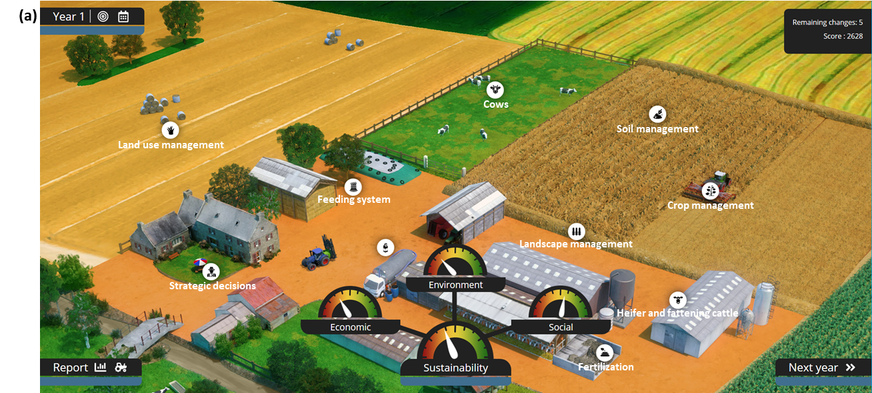
Game interface
Simple and intuitive interface, adapted to all players
Agregated indicators of sustainability
Score : linked to the weakest pillar of sustainability
Gamification : badges, high score table (soon)

Slide 12
An effort of adaptability
Accessible to all study levels: list of predefined practices (feeding rations, crop rotations)
Accessible to international users: game is freely available in 6 langages, with tutorials and pedagogical documents
4 predefined farms (BE, FR, IT, PL), possibility to create your own farms
Versatile teaching tool: option to create custom scenarios, teacher interface to follow multiple players in live, discussion of results
Source code in Javascript, open licence CC-BY
Soon a comminity of users and improvers?

Slide 13
Thanks for your attention

