Slide 1

SEGAE – Teacher Session
The animal module
Joanna Makulska, Nathalie Bareille et al.
Avec le soutien de

Slide 2
What About the animals IN SEGAE ???
Agroecology in dairy farming

Slide 3
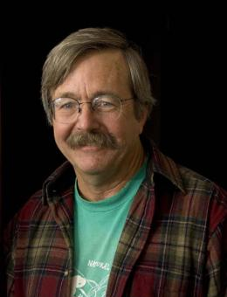
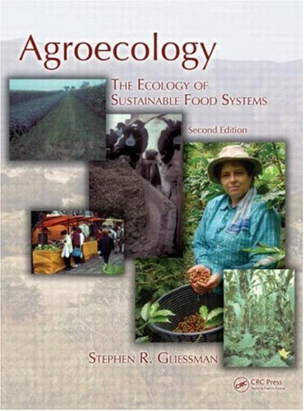
Agroecology and livestock
Stephen Gliessman
Santa Cruz University
« The problem lies not in the animals themselves or in the consumption of animal products, but rather in the way they are integrated into agroecosystems »
« Understanding the integration of the animal in its agro-ecosystem provides levers for reconciling environmental and economic concerns in a sustainable manner »

Slide 4
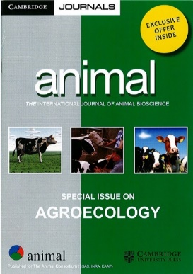
Agroecology and livestock

Slide 5
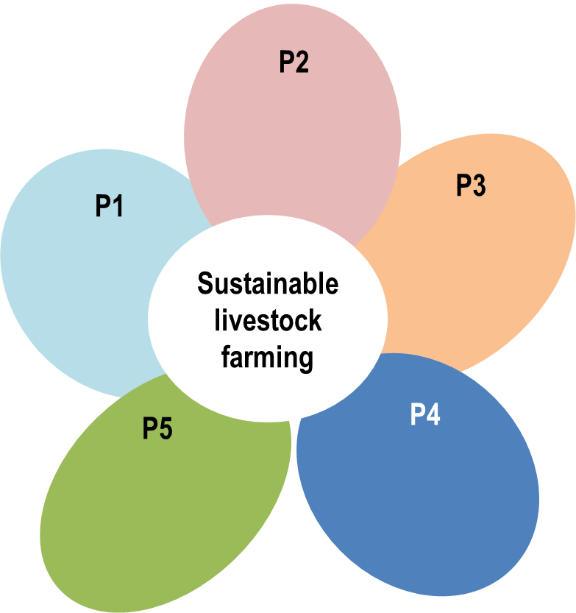
Agroecology and livestock
Five principles for the development of ecology-based alternatives for animal production
Dumont et al. 2013

Slide 6
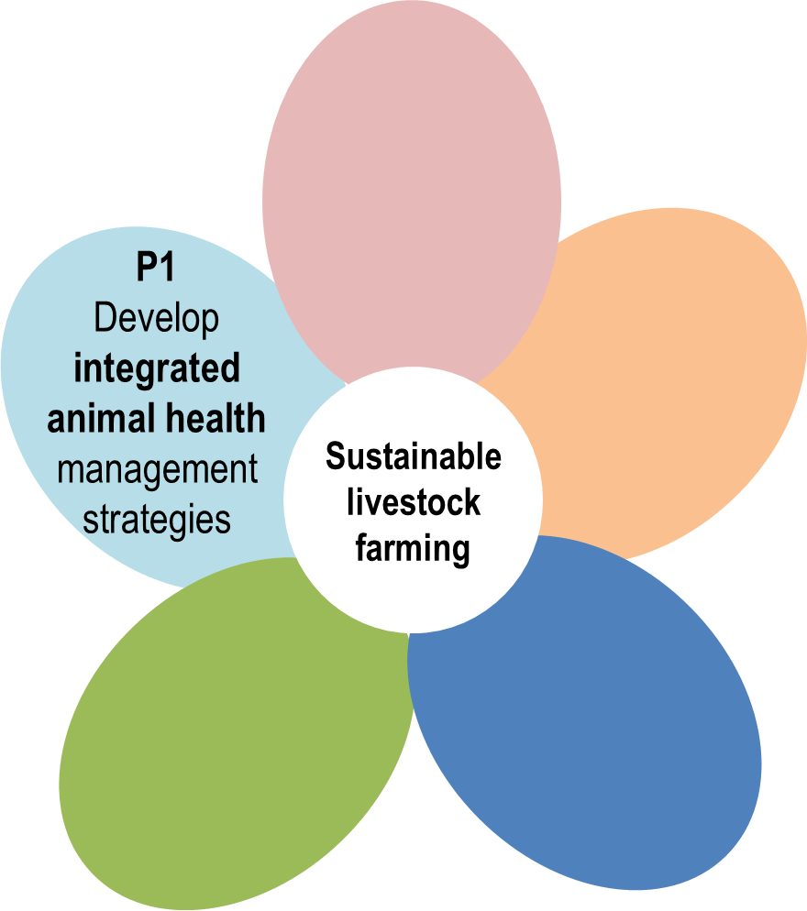
Agroecology and livestock
Five principles
Dumont et al. 2013
… to improve the balance between welfare and production
by enhanced animal adaptation abilities and
by reduced drug use

Slide 7
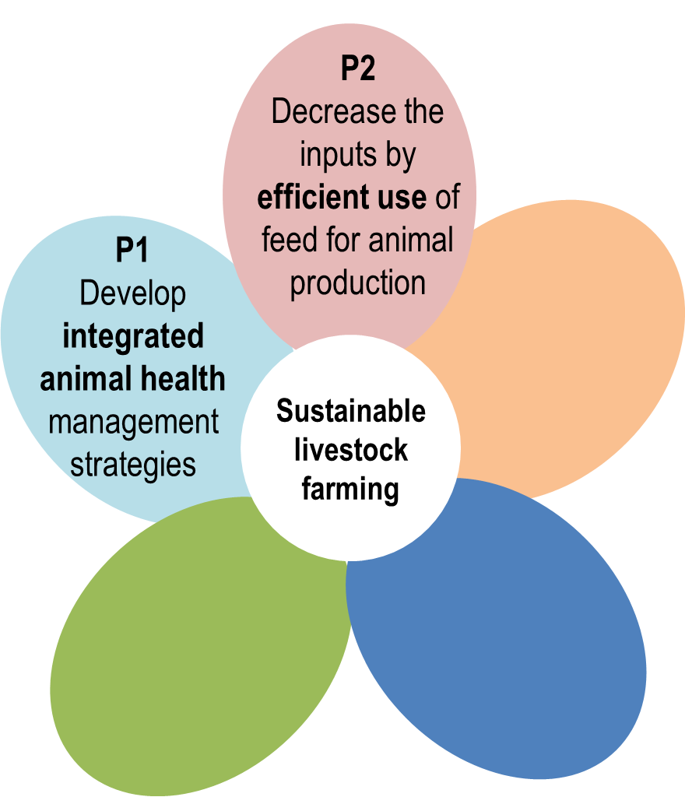
Agroecology and livestock
Five principles
Dumont et al. 2013
… by increasing the animal efficiency for limiting ressources (Nitrogen & Energy) and
by limiting food-feed competition,

Slide 8
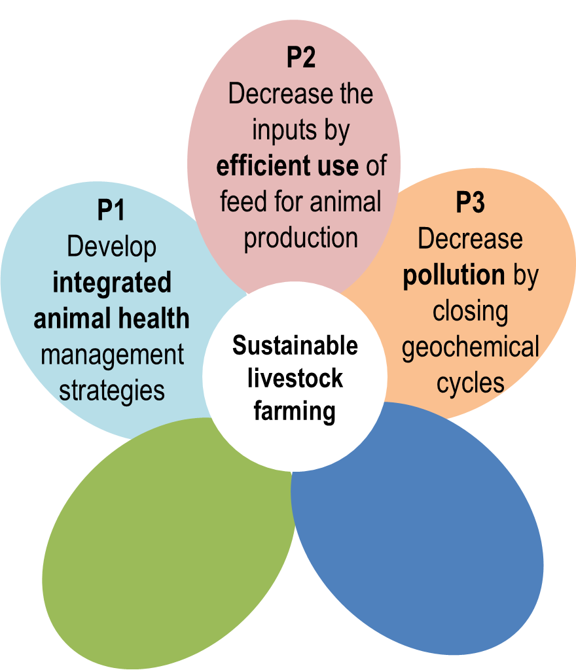
Agroecology and livestock
Five principles
Dumont et al. 2013
… by balancing the effluent production and the crop requirements

Slide 9
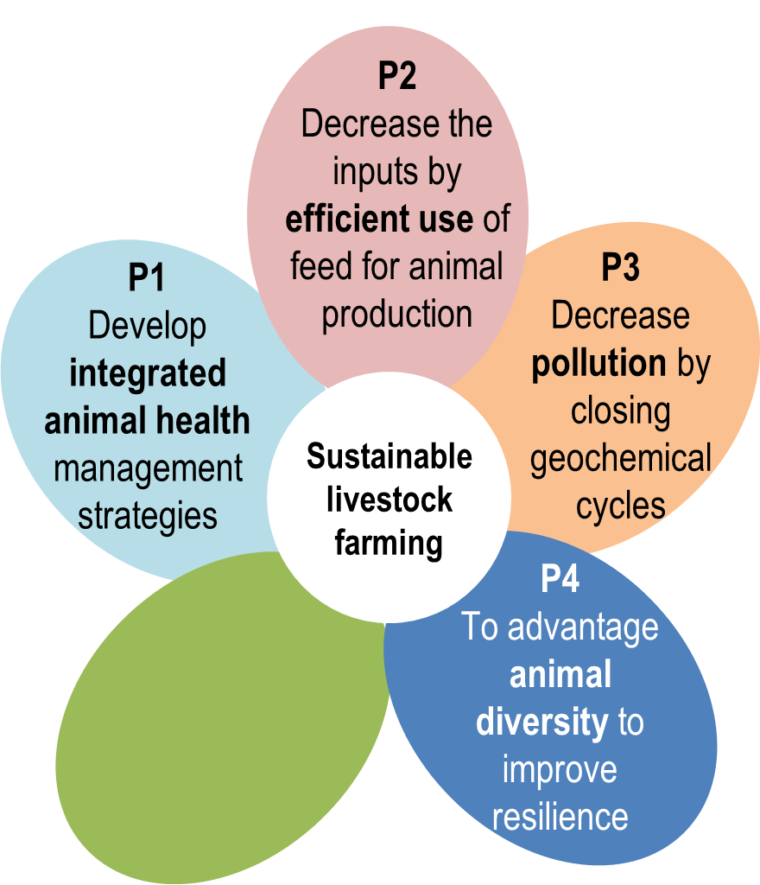
Agroecology and livestock
Five principles
Dumont et al. 2013
… by mixing the species in a system, or even
by using animal diversity within a herd

Slide 10
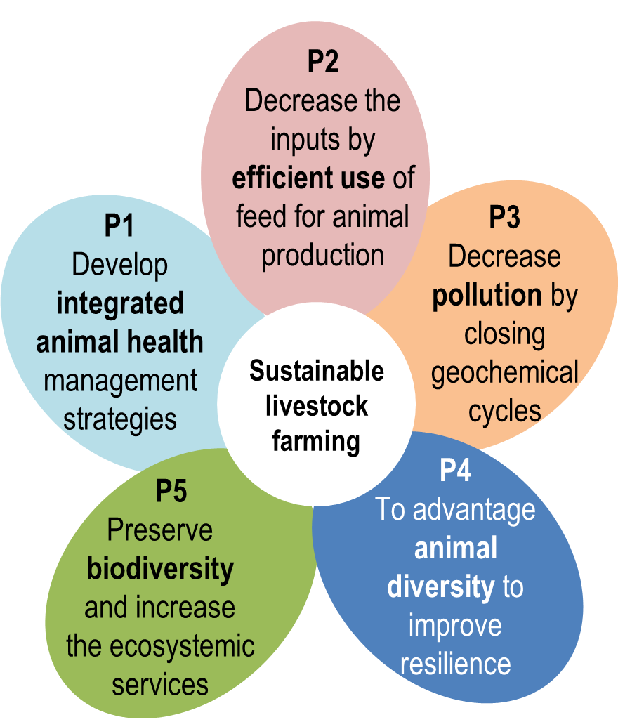
Agroecology and livestock
Five principles
Dumont et al. 2013
… by enhancing domestic biodiversity and
by developping ecologically valuable lands at farm and landscape scales

Slide 11
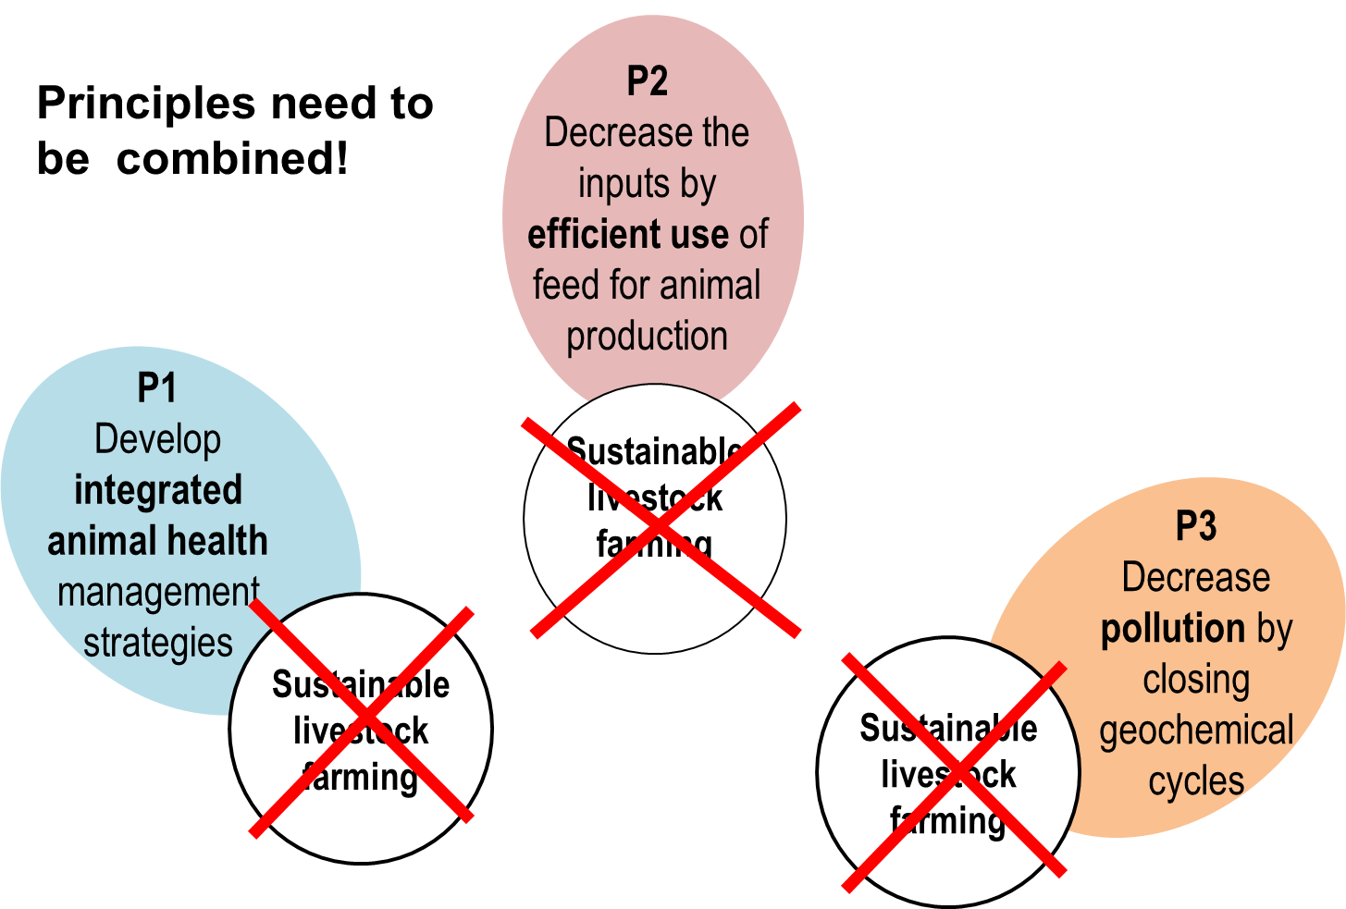
Agroecology and livestock

Slide 12


Agroecology and livestock
Different combinations can be agroecological

Slide 13
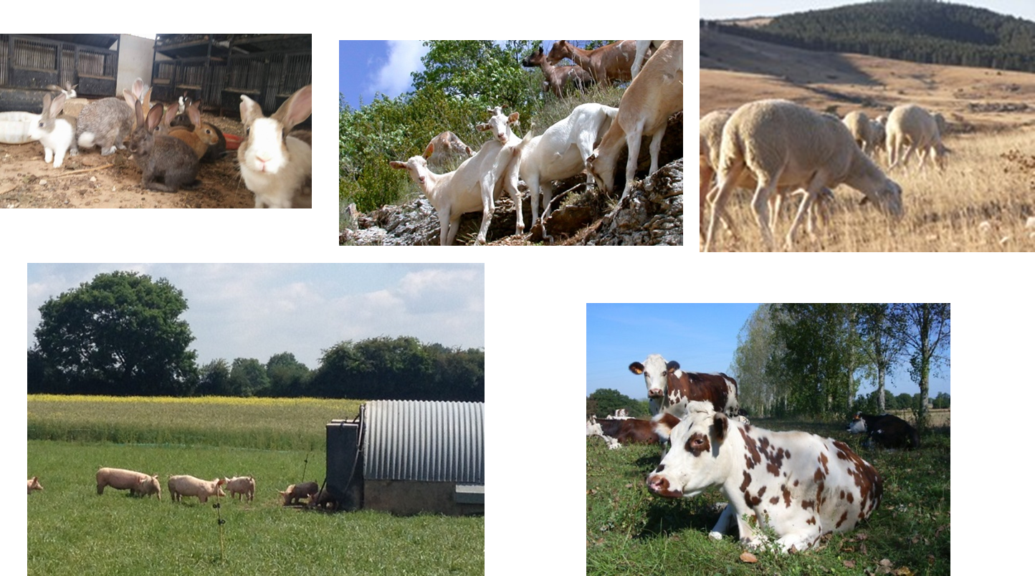
Agroecology and livestock
Different combinations can be agroecological

Slide 14
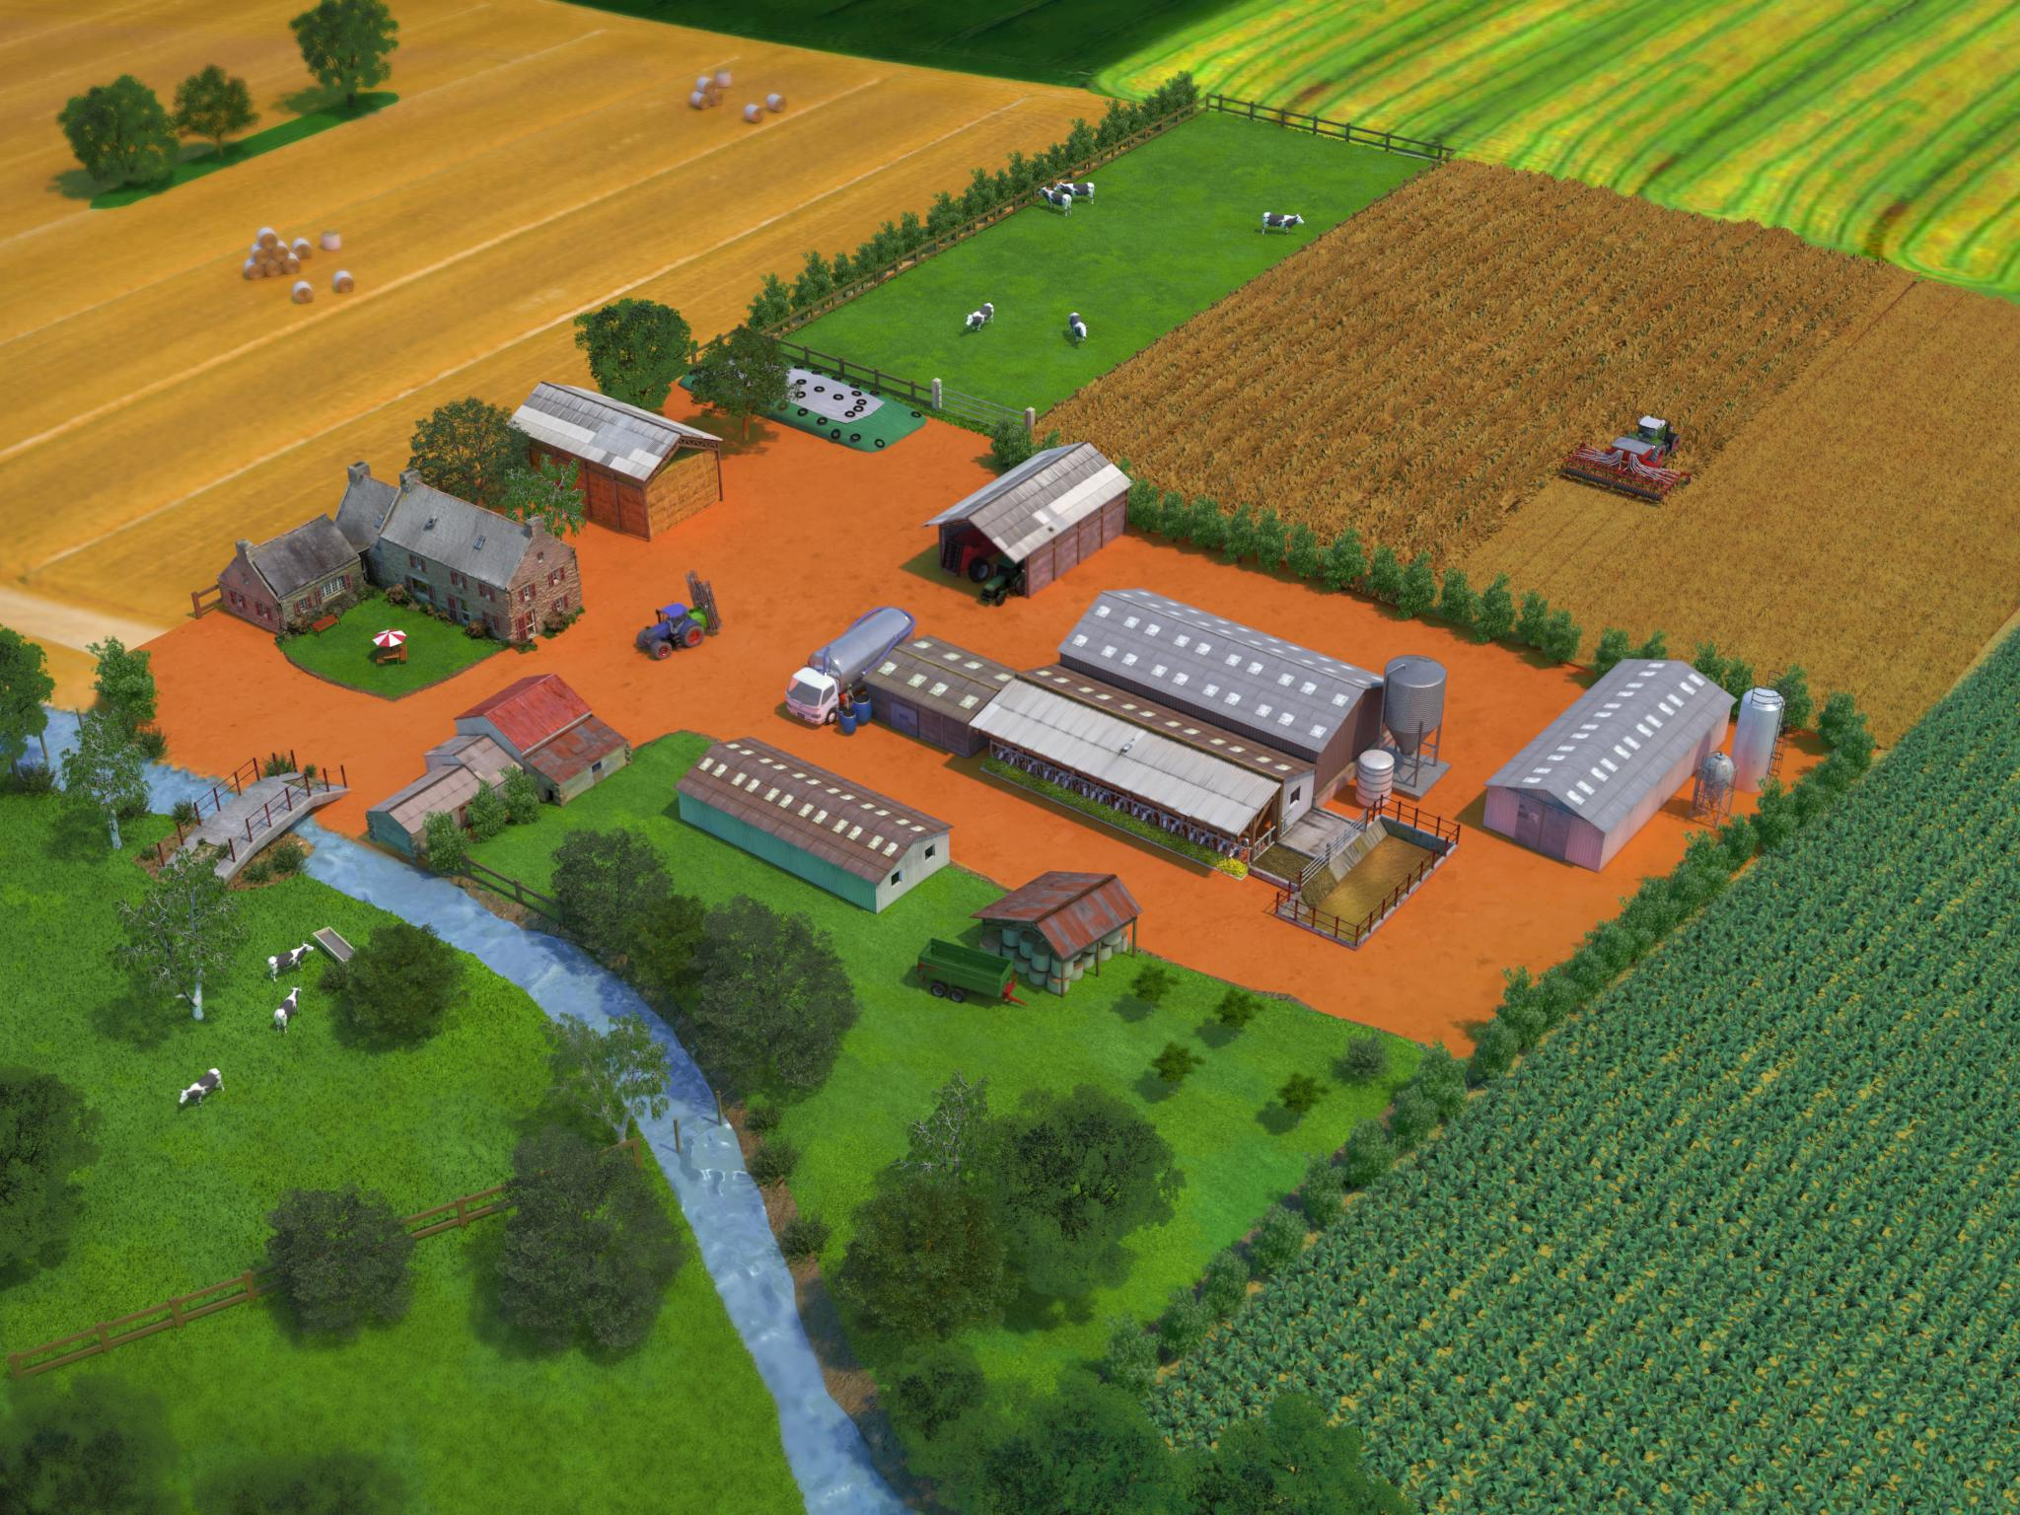
Agroecology and livestock
What are the levers in the animal model?

Slide 15
Agroecology and livestock
What are the levers in the animal model?
Change the cattle breed: from Holstein to a local breed
Modify the herd size: decrease … or increase
Change the animal housing system: from tied … to cubicles with slatted floors … to free-stall with deep straw bedding
Change the animal feeding system:
from all year indoor / silage maize, soybean meal supplement
… all year indoor / sorghum and alfalfa silage
… 5 months grazing / rapeseed meal supplement
to 9 months grazing without protein feed supplement
Change the parasite management: from systematic anthelminthic treatment … to selective targetted anthelminthic treatment… to no treatment

Slide 16
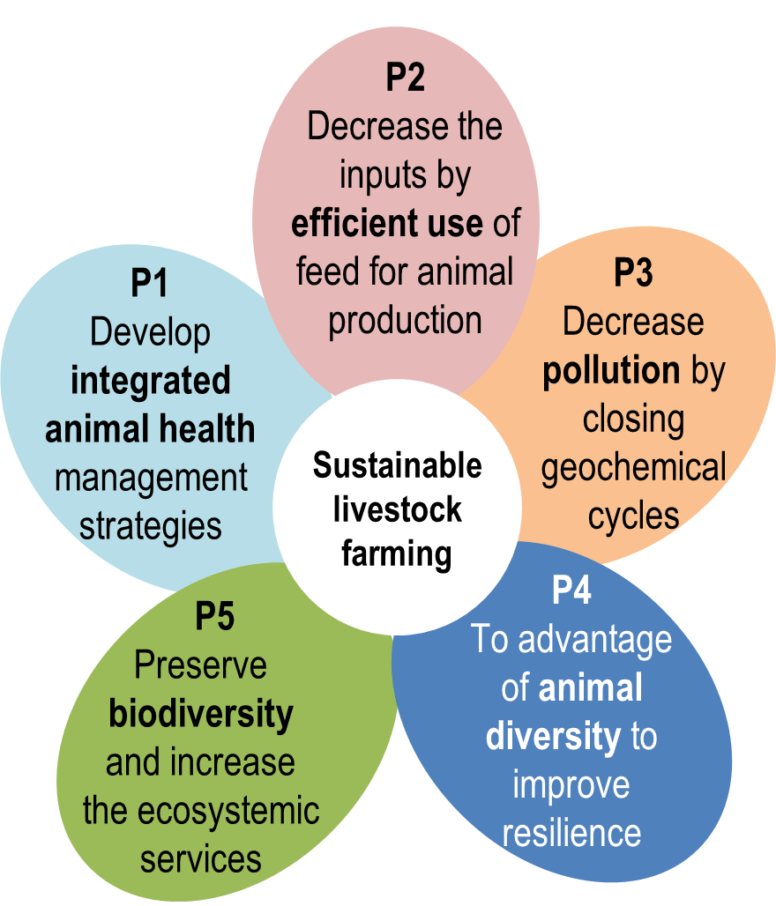
Agroecology and livestock
What principles are targeted with these levers?
?
?
?
?
?
Cattle breed
Herd size
Animal housing system
Animal feeding system
Parasite management

Slide 17
Agroecology and livestock
What principles are targeted with these levers?
5
2, 3
1, 3
2, 3, 5
1, 5
Cattle breed
Herd size
Animal housing system
Animal feeding system
Parasite management

Slide 18
What About the animals IN SEGAE ???
Merci de votre attention

