Slide 1

SEGAE – Teacher Session
Crop-soil-ecology Modules
Benjamin Dumont et al.
Avec le soutien de

Slide 2
From Science to serious game
Agro-Ecology : Concept and knowledge

Slide 3
Where does SEGAE lies in the AE concept
Agroecology has to be seen as a continuum of agricultural practices, instead of a fixed minimal set of specifications/practices to be met (e.g. organic farming) !

Slide 4
Where does SEGAE lies in the AE concept
Agroecology has to be seen as a continuum of agricultural practices, instead of a fixed minimal set of specifications/practices to be met (e.g. organic farming) !
SEGAE is a realistic game that represent a potential reality – This is not « the reality » !

Slide 5
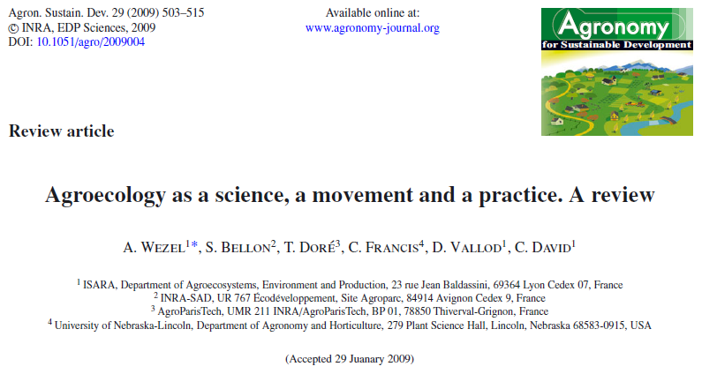
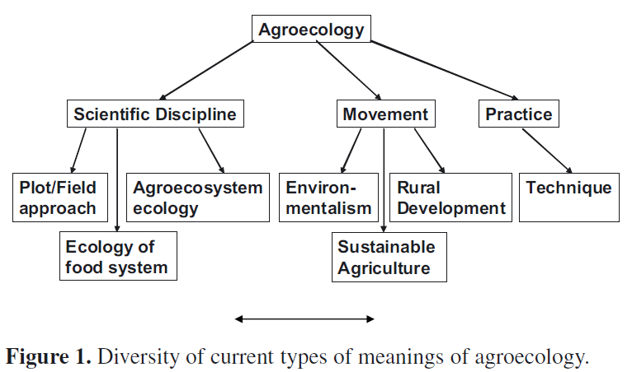
Where does SEGAE lies in the AE concept

Slide 6
Where does SEGAE lies in the AE concept

Slide 7
The concept behind Soil-Crop-Ecology module
Let’s consider the following example :
In Nature there are auxiliary insects, that have an impact through predation on harmful insects, which impact detrimentally crop production
Auxilliary
Predation
Pest
Pressure
Production

Slide 8
The concept behind Soil-Crop-Ecology module
In this system :
Auxilliary and harmful insects (pest) are biological structures (or describe fonctional biodiversity)
Predation and pressure are process and ecological functions
Crop production is a provided service
Indicators
Biological structure
Process
Services
Auxilliary
Predation
Pest
Pressure
Production

Slide 9
The concept behind Soil-Crop-Ecology module
Pratices and AE levers will influence this reaction chain
Practices
Indicators
Biological structure
Process
Services
Practice X
Auxilliary
Predation
Pest
Pressure
Production

Slide 10
The concept behind Soil-Crop-Ecology module
Describe all the fluxes at the agro-ecosystem level is very complex.
Furthermore a practice can be implemented in sequence or in parallel with other pratices.
Practices
Indicators
Biological structure
Process
Services
Practice X
Auxilliary
Predation
Pest
Pressure
Production

Slide 11
The concept behind Soil-Crop-Ecology module
On the contrary, litterature is full of references reagrding the impacts of practices on one or more indicator(s)
We by-passed the reaction chain approach
to propose an output-oriented approach
Practices
Indicators
Biological structure
Process
Services
Practice X
Auxilliary
Predation
Pest
Pressure
Production

Slide 12
Where does SEGAE lies in the AE concept
We offer an integrated vision of the Soil-Crop and Ecology modules that allows to
  Develop knowledge on the impacts of AE practices in terms of ecosystem services
  (and their intensity)
  Develop a system-thinking approach that consider the (interactive) impacts of AE practices

Slide 13
Develop knowledge on the impacts of AE practices

Slide 14
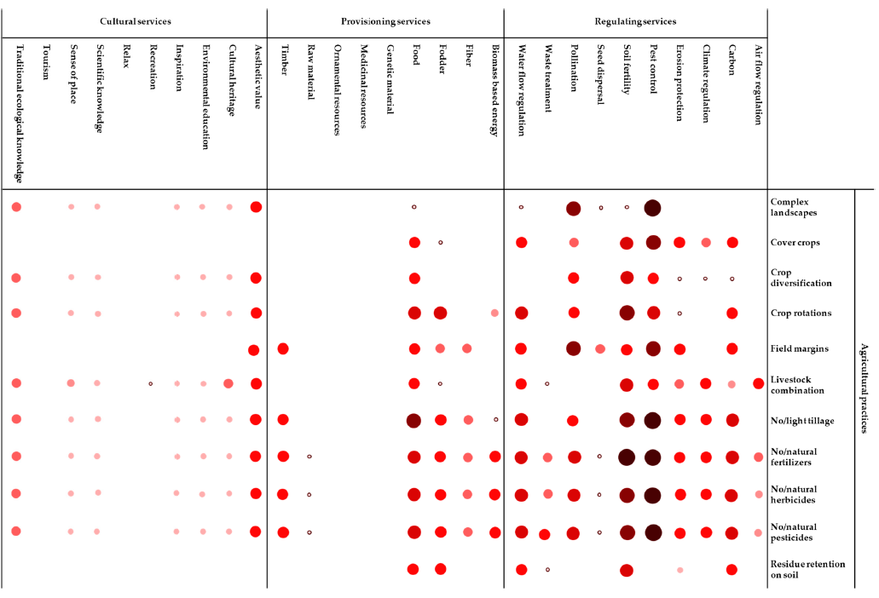
Develop knowledge on the impacts of AE practices
Palomo-Camesino et al. Exploring the connections between agroecological practices and ecosystem services : A systematic literature Review – MDPI Sustainability, 10, 4339, doi : 10,3390/su10124339

Slide 15
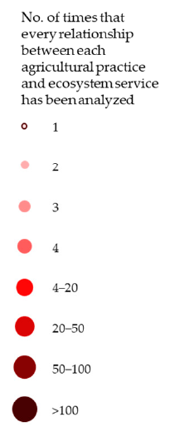
Develop knowledge on the impacts of AE practices

Slide 16
Develop knowledge on the impacts of AE practices
A practice give multiple services

Slide 17
Develop knowledge on the impacts of AE practices
A practice give multiple services
One service can be provided by multiple practices

Slide 18
Develop knowledge on the impacts of AE practices
A practice give multiple services
One service can be provided by multiple practices
At each intersection, this is the intensity of the service provided by a practice that vary !

Slide 19
Develop knowledge on the impacts of AE practices
A practice give multiple services
One service can be provided by multiple practices
At each intersection, this is the intensity of the service provided by a practice that vary !
What should you choose to do ?

Slide 20
Develop a system-thinking approach

Slide 21
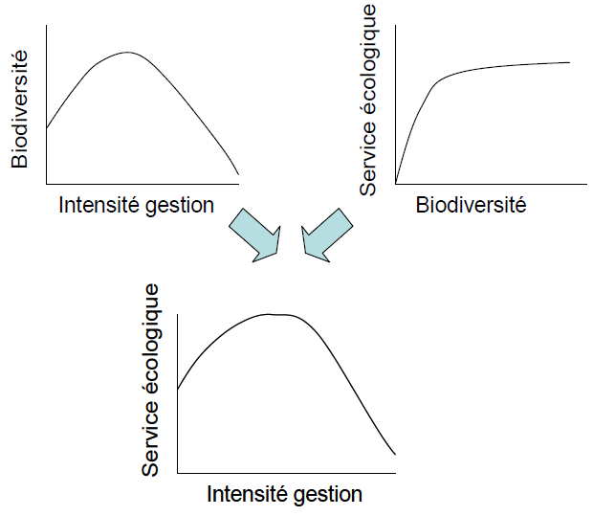
Develop a system-thinking approach
The concept
Biodiversity
Ecological service
Management intensity
Biodiversity
Ecological service
Management intensity
Adapted from : Agriculture et biodiversité – Valoriser les synergies . 2008. Expertise scientifique collective

Slide 22
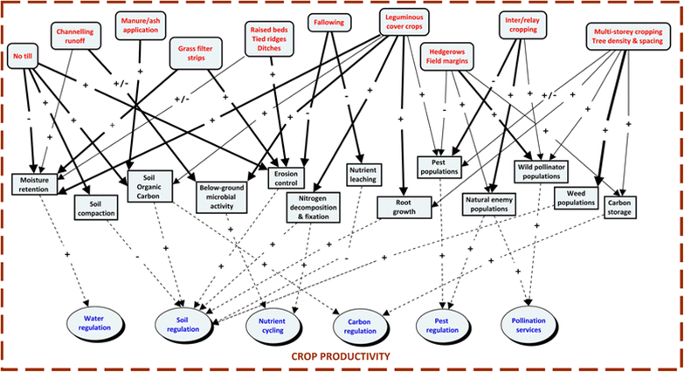
Develop a system-thinking approach
The reality
Thorn J. et al. 2015. How effective are on-farm conservation land management strategies for preserving ecosystem services in developing countries?
A systematic map protocol. Environmental Evidence. 4:11. DOI 10.1186/s13750-015-0036-5

Slide 23
Develop a system-thinking approach
Example in the game – Let’s play !
Original practice | AE practice | Indicators / ES
 |  | Yield | SOC
Convent. tillage | Red. tillage
- | No tillage

Slide 24
Develop a system-thinking approach
The solution offered by “science” (literature, expertise, etc.)
Original practice | AE practice | Indicators / ES
 |  | Yield | SOC
Convent. tillage | Red. tillage | = | =
- | No tillage | 0,92 | =

Slide 25
Develop a system-thinking approach
Interaction between practices
Original practice | AE practice | Indicators / ES
 |  | Yield | SOC
Convent. tillage | Red. tillage | = | =
- | No tillage | 0,92 | =
From an indicator to another,
the effects of practices are multiplicative or additive

Slide 26
Game description
Agro-Ecology : Typology and gradient of practices

Slide 27
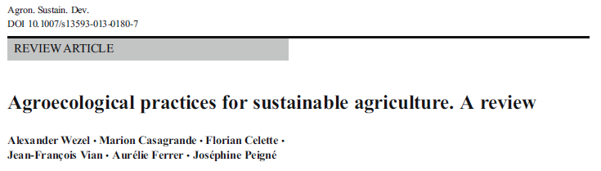
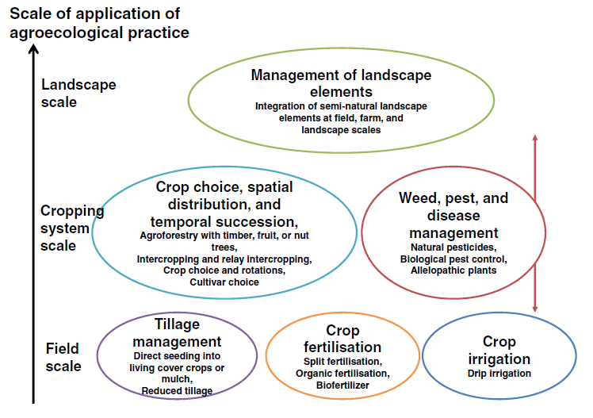
Choosing your practices depending upon the scale considered

Slide 28
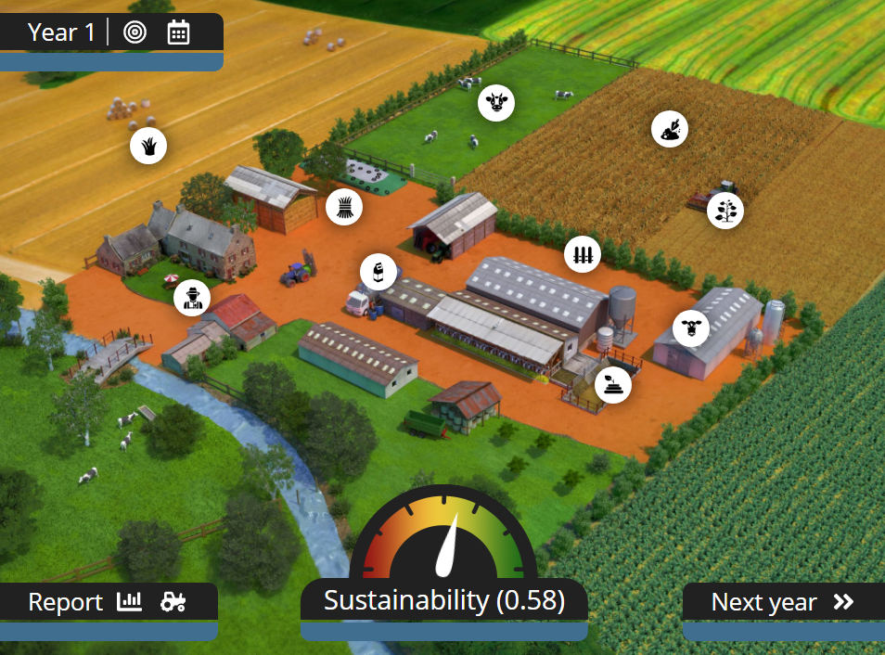
The concept
Field Scale
Scale of action of AE practices
Cropping system Scale
Landscape Scale
Adapté de Wezel et al. 2013 - Agroecological practices for sustainable agriculture. A Review

Slide 29
Practices at field scale
Fertilisation
Tillage
Field Scale
Irrigation

Slide 30
All at once
PGPR
Practices at field scale
Split
Fertilisation
Organic - granen
Organic - Manure
Organic - Slurry
Conv. tillage
Full irrigation
Tillage
Field Scale
Irrigation
Reduced tillage
Soil mulch
Drip irrigation
No-till + direct seeding
No irrigation

Slide 31

All at once
PGPR
Practices at field scale
Split
Fertilisation
Organic - granen
Organic - Manure
Organic - Slurry
Conv. tillage
Full irrigation
Tillage
Field Scale
Irrigation
Reduced tillage
Soil mulch
Drip irrigation
No-till + direct seeding
No irrigation

Slide 32
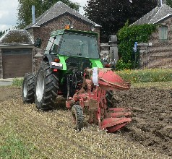
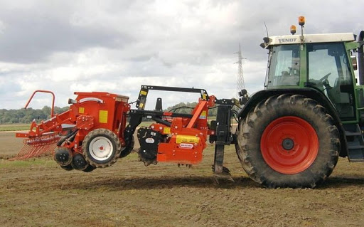
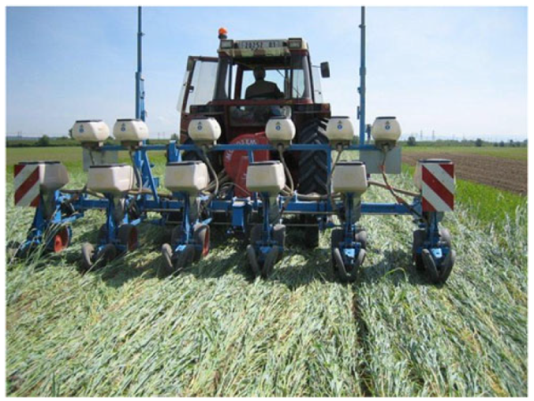
Practices at field scale
Example : soil tillage
Conventionnal tillage
Reduce tillage
No-tillage

Slide 33
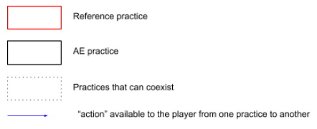
Practices at field scale
Example : soil tillage

Slide 34
Practices at cropping system scale
Temporal succession
Insect
management
Spatial distribution
Cropping syst. scale
Disease management
Crop and cultivar choice
Weed management

Slide 35
Practices at cropping system scale
Weed management
Insect management
Cropping syst. scale
Fungus management

Slide 36
IPM + Mech.
Practices at cropping system scale
Mech. weed.
Weed management
IPM chemic.
Nothing
Nothing
Insect management
Cropping syst. scale
Fungus management
Bio-
control
Bio-
control
System. Chemic.
System. Chemic.
IPM chemic.
IPM chemic.

Slide 37
Practices at cropping system scale
Spatial distribution
Crop and cultivar choice
Cropping syst. scale
Temporal succession

Slide 38
Practices at cropping system scale
Sole crop
Inter-cropping
Spatial distribution
Residues managt.
Legume crop
Cover crop
Ratio Permanent grassland
Temporary grassland
Land use
Crop and cultivar choice
Cropping syst. scale
Temporal succession
Temporary grassland composition
Monocrop
& Short rotation
Long rotation
Cultivar choice
Medium rotation

Slide 39

Practices at cropping system scale
Sole crop
Inter-cropping
Spatial distribution
Residues managt.
Legume crop
Cover crop
Ratio Permanent grassland
Temporary grassland
Land use
Crop and cultivar choice
Cropping syst. scale
Temporal succession
Temporary grassland composition
Monocrop
& Short rotation
Long rotation
Cultivar choice
Medium rotation

Slide 40
Practices at landscape scale
Landscape complexity
Landscape scale
Green infrastruct.

Slide 41
Practices at landscape scale
Grass margins
Low complex.
High complex.
Beetle bank
Hedgerows
Landscape complexity
Landscape scale
Green infrastruct.
Wild-flowers strip
No element
Agroforestry

Slide 42
From game concept to game-play
Agro-Ecology in action – Some specificities

Slide 43
The land use in the SEGAE farm
My farm – X ha
The initial farm is X ha (country dependent)

Slide 44
The land use in the SEGAE farm
My farm – X ha
The initial farm is X ha (country dependent)
Permanent pasture accounts for 0, 10 or 20%
Two cropping systems occupy the cultivated land -each system occupied 50% of the remaining surface
Permanent pasture : 0 - 10 - 20 %
Cropping
system #1
Cropping
system #2

Slide 45
The land use in the SEGAE farm
My farm – X ha
The initial farm is X ha (country dependent)
Permanent pasture accounts for 0, 10 or 20%
Two cropping systems occupy the cultivated land -each system occupied 50% of the remaining surface
The area occupied by each crop is automatically computed depending upon the rotation that are implemented in each systems
Permanent pasture : 0 - 10 - 20 %
Maize
Potato
Winter
Wheat
Winter
Wheat
Rapeseed
Winter
Barley
Winter
Wheat
Cropping system #1
Cropping system #2

Slide 46
Pre-defined cropping systems
Predefined cropping systems are proposed to the player, based on the cultural diversity of crops :
Low diversity
Medium diversity → Without legume and without temporary pasture
Medium diversity → With legume and without temporary pasture
Medium diversity → Without legume and with temporary pasture
High diversity → With legume and with temporary pasture

Slide 47
Pre-defined cropping systems
Predefined cropping systems are proposed to the player, based on the cultural diversity of crops :
Low diversity
Medium diversity → Without legume and without temporary pasture
Medium diversity → With legume and without temporary pasture
Medium diversity → Without legume and with temporary pasture
High diversity → With legume and with temporary pasture
Exp : The French farm

Slide 48


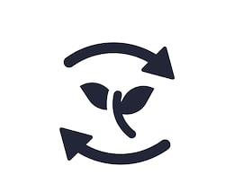
Equilibrium production – self-consumption
To answer the question of « how to feed animals », the principles are :
Each production that can be self-consumed on farm, will be;
Everything not produced on farm will automatically be bought.

Slide 49
Thanks for your attention

