Slide 1
SEGAE – Teacher Session
Pedagogical tools as complements to SEGAE
Suzanne Bastian
Avec le soutien de

Slide 2
Tools for building a learning session with SEGAE
Pedagogical tools as complements to SEGAE

Slide 3
Pedagogical tools as complements to SEGAE
Short « how to play » tutorials (vidéos)
Pedagogical guide
Type scenarios and examples of learning sessions
Additional ressources
Scientific publications

Slide 4
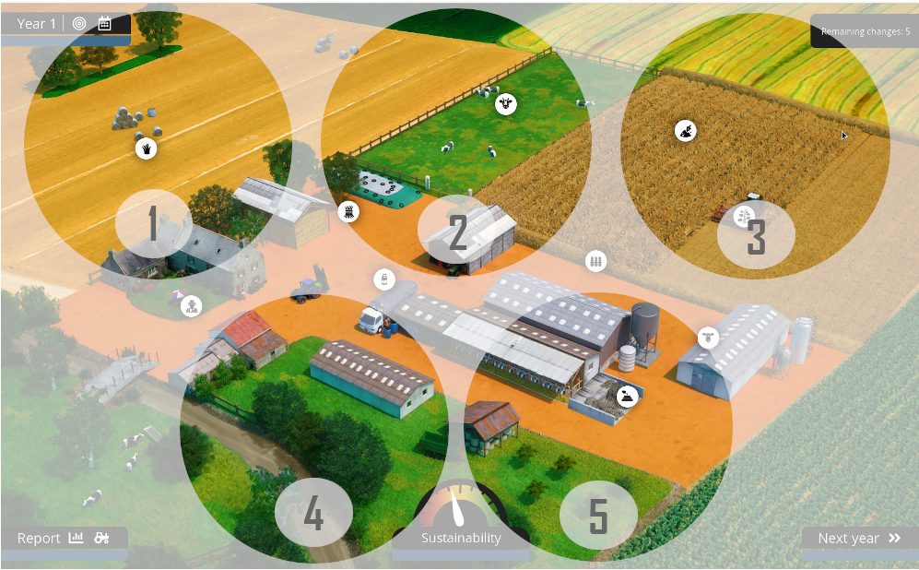
1. Short « how to play » tutorials (vidéos)
5 short videos to get started (Youtube) :
http://mc.wipie.ur.krakow.pl/segae/

Slide 5
2. Pedagogical guide
Introduction
Classroom setup and requirements
Real classroom
Virtual classroom
Learning objectives
General objectives
Detailed objectives inspired by Bloom’s taxonomy (for outcome-based evaluation)
Session building blocks
Scenarios
Sample sessions
Quizzes for evaluation

Slide 6
3. Type scenarios and sample learning sessions
Type scenarios of growing complexity
1. « Sandbox » : Hands-on discovery of the game
2. Relating animal feed demands to feed production
3. Enhancing one particular sustainability indicator, while maintaining or improving overall sustainability
…
Assembled into sample learning sessions

Slide 7
4. Additional resources
Short videos on basic concepts of
agronomy
breeding
soils
farm economy
social aspects
ecosystem services
Links to interesting external resources
e.g. dictionary of agro-ecology https://dicoagroecologie.fr/

Slide 8
5. Scientific papers from the SEGAE project
Jouan J., De Graeuwe M. et al. 2020
“Learning Interdisciplinarity and Systems Approaches in Agroecology: Experience with the Serious Game SEGAE », Sustainability
https://www.mdpi.com/2071-1050/12/11/4351
Jouan et al. (under review 5/10/2020) and associated datapaper
“SEGAE: a serious game to learn agroecology”

Slide 9
Thank you for your attention

