Slide 1
SEGAE – Teacher Session
Build your own custom scenarios
Matthieu Carof, Olivier Godinot
Avec le soutien de

Slide 2
Scenario creator
The farm
Chose the practices to start with
Change parameters such as agricultural area, number of workers, etc.
Define the game objectives to be reached
The context
Change parameters such as prices, attainable yield, etc.
Create random events to introduce hasards which will increase realism and game complexity

Slide 3
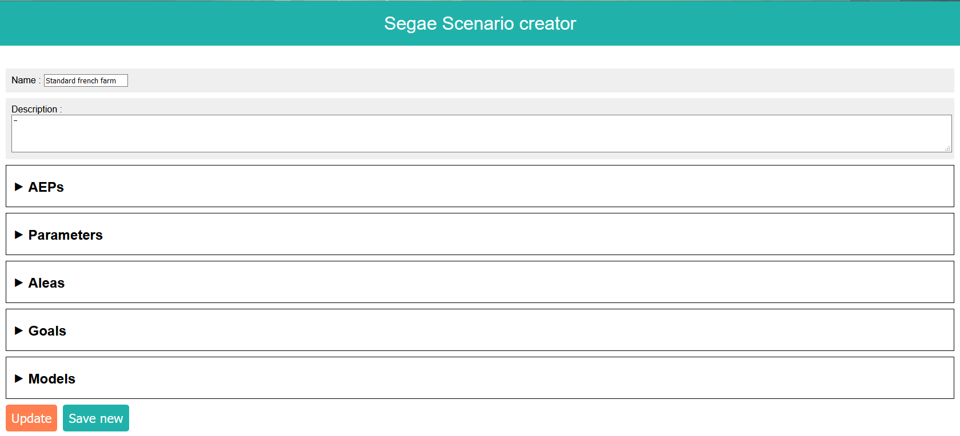
Scenario creator

Slide 4
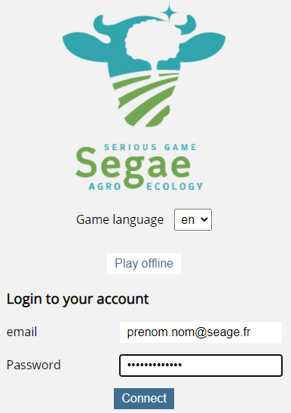
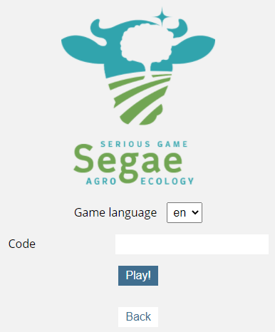
Tutor App
Teachers can create virtual rooms, and invite their students to join with a unique code
In this room, all players play the same game with same parameters and rules, in limited time (or not)

Slide 5
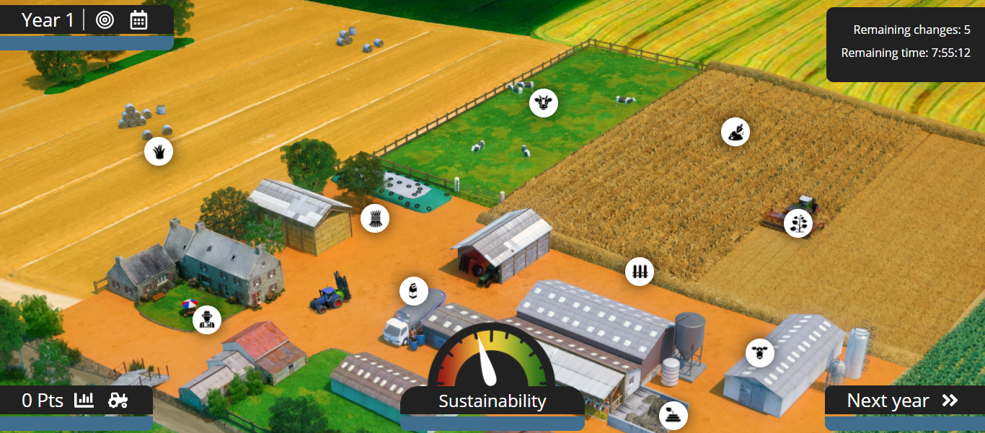

Slide 6
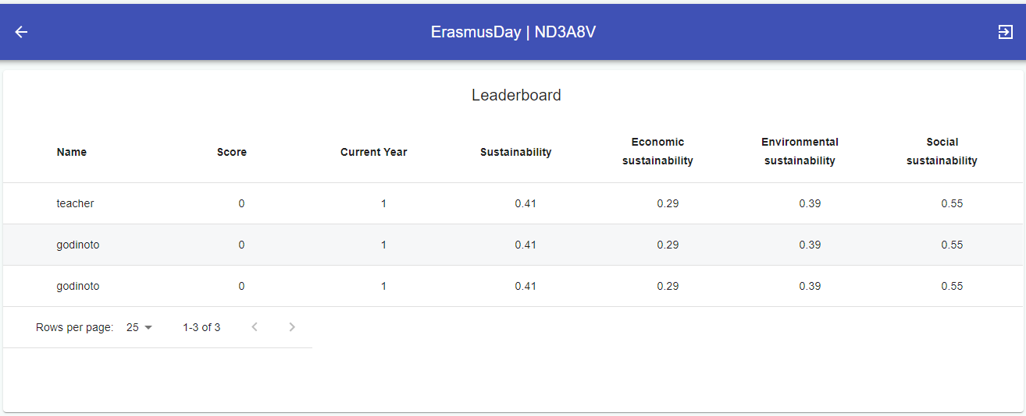
Sustainability scores of all players are displayed to the teacher in real time

Slide 7
